Slide 1

Missing person finder guide: dr. Sumathi d Review – 1
Capstone project
Team members:
d.Sai kumar – 19bcs0080
m.Dhillipkumar – 19bcs0089
p.Cheranbabu - 19bcs0097

Slide 2
Introduction
To make task easy of finding missing person we developed a Mobile Application called
“MISSING PERSON FINDER” .
The ‌ MISSING PERSON FINDER ‌ app is organized into several sections. On the first nav button you can find dashboard where the missing people reports will be found, in the second nav button you can find the form where the missing person details will be reported, on the third you will see the notification tab, and at last there is a “profile" tab with all of your settings and info.
This project is deployed in the google playstore where all the android users can download this application easily.

Slide 3
LITERATURE SURVEY:
Theoretical Review:
Research concerning missing persons has been done in the past. A few of the research efforts have been successfully implemented while others did not see the light of the day for a number of reasons. These past researches can enable us to develop a lens through which to view the phenomenon under study.
1) Google Person Finder
Following Haiti’s earthquake in January 2010, Google developed an open source web application Person Finder, which is a registry and message board for survivors, family and friends to post and search for information about one another's whereabouts following a natural disaster. Up until now, following five natural disasters, the registry has collected more than 200,000 names.

Slide 4
3) San Francisco 311 Customer Service Centre
In his report entitled 'Post-Disaster Missing Persons Process: San Francisco 311 Customer Service Centre', Millman (2013) highlighted that in the event of a natural or manmade disaster in San Francisco, the City and County of San Francisco would expect an extraordinarily high call volume from people reporting missing persons. The residents, businesses, and visitors whom 311 serve would contact the Office of the Chief Medical Examiner (OCME), the police department, or local hospitals. These calls would detract from the capacity of these crucial organizations to focus their resources on responding to the disaster. The call volume required personnel to divert resources from other primary tasks.
This is clear proof that the development of a robust mobile based emergency communication system that is open to the public would be an ideal way to obtain more capacity for rescue and locating missions by involving the public.

Slide 5
4) The Dutch Cell Broadcast
The Dutch government has also adopted a mobile phone danger alert system that sends text messages to people who could be affected by natural disasters or terrorist attacks. The system, called Cell Broadcast, uses GSM technology to identify cell phone users in a particular area. If a disaster occurs, a message is sent to all phones in the area, warning of the danger.
CNN's reporter, Clothier (2005) reported that the Cell Broadcast system will be used in addition to the other warning systems which are currently used if disaster strikes, such as sirens and special emergency broadcasts on radio and television. This is a more instantaneous way of informing people about what is going on real time. It's an extra medium to communicate directly with people during a disaster.

Slide 6
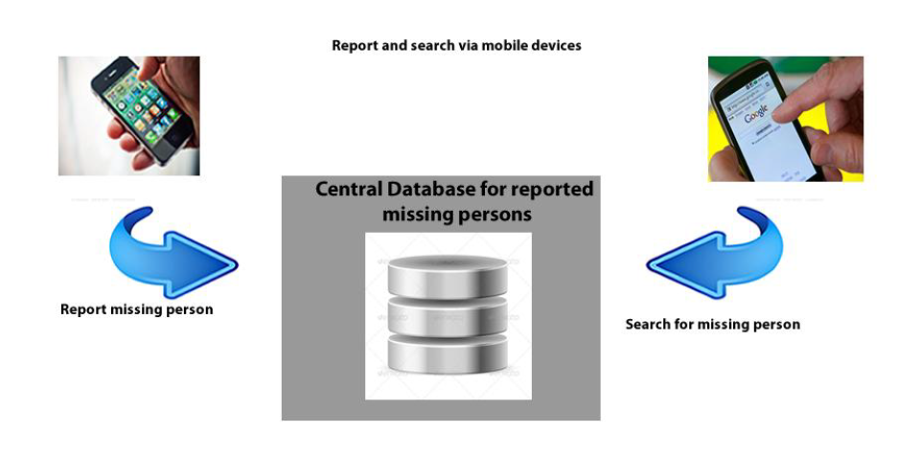
B) Conceptual framework
There is need to record more success in such applications because only a small portion of victims have benefited .
It can be a highly considered opinion to suggest an emergency communication system, because it is easy and readily accessible .Many people access internet and can gain access to such applications.
Therefore a more viable and useful approach to it would be the development of a mobile application, that gives both the victims and their family members a chance to communicate and reunite.
This is likely to tremendously increase usage and subsequently success. The given diagram enables more people to access a supportive system with ease and convenience, given that mobile and internet access has increased rapidly in the modern world.

Slide 7
PROBLEM STATEMENT:
Manual System for finding missing person has very long procedure and takes more time. More time is required for launching an FIR (First Information Report) in police station. Also time required for finding lost person is more. Also during manual process number of manpower for searching lost person is less. Some existing application does not show the proper information about the Missing person, which is difficult to find out missing person. Some missing person related website only shows the database of missing person. In some amusement parks and other public venues, they have used RFID (Radio Frequency Identification) chip for searching Missing Children.

Slide 8

To overcome from this, there exist some mobile applications has been developed. But these applications has certain limitations as,
Problems in Existing Mobile Applications:
Previous application only contains link which redirect to their website.
User can not add complaint.
User can’t track their Missing reports
It displays advertisements collected from newspapers.

Slide 9
PROPOSED STATEMENT
To overcome from these drawbacks we are developing Proposed System as "Missing Person Finder (MPF)". This application is basically designed to perform all the tasks that previous system can perform all functionalities that are provided by existing applications as well as it gives additional feature to user. It will be for all Android Smartphone Devices which support at least Android 6.0 (Marshmallow) Platform. We got idea about how User Interface should be for adding new complaint, getting on-time notification, searching person using filter and also creating chat facility from this Mobile Application.
Proposed System will contain following features:
Display Information about missing person.
Adding new complaint.
Removing Complaints.
Searching person by particular attribute such as name, age, etc.
Notification Portal.
Chat facility to communicate

Slide 10
Advantages of Proposed System over Existing System:
Easy to upload and view Complaint.
All trust Users can add complaint.
Simple and clean Graphical User Interface (GUI).
Easy to communicate Information among trust Users.
Disadvantages of Proposed System:
Require Internet connection.
Require Smart phone with camera.

Slide 11
TECHNOLOGIES LANGUAGE AND SOFTWARE / HARDWARE RELATED TO PROPOSED SYSTEM:
Hardware Requirement:
Intel Core i3 6th gen Dual-Core 3.7 GHz Processor
2 GB RAM minimum, 8 GB recommended
2 GB of available Disk space minimum, 4 GB recommended (500 MB for IDE/Tools + 1.5GB for Android SDK and Emulator System Image)
1280 x 800 minimum screen resolution.

Slide 12
Software Requirement:
Microsoft Windows 10 (64-bit)
Java Development Kit (JDK) 8 installed and set in system environment variables.
Java Runtime Environment (JRE) 6
Android SDK
Android Studio
Eclipse IDE for Java Developers
Android Development Tool kit (ADT-kit)
Connected Mobile Device with laptop for run and test the Application.

Slide 13
SYSTEM ANALYSIS AND DESIGN
The following diagrammatic representations give an overview of the system analysis.

Slide 14
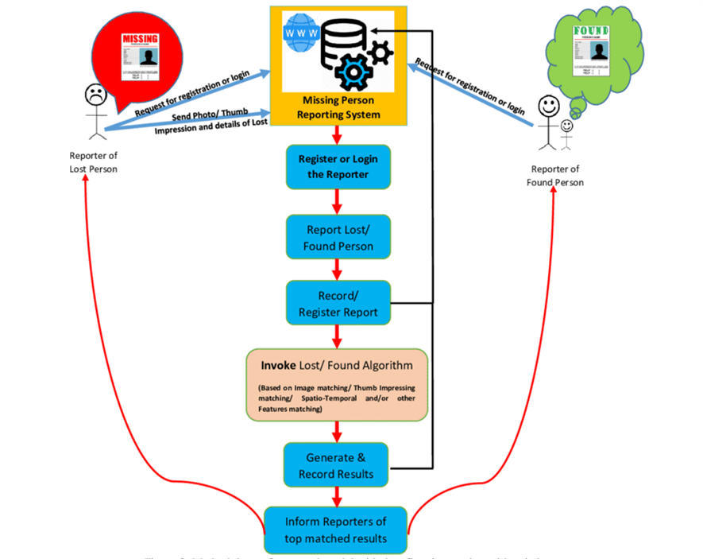
System Architecture:
The app members will search by using reports

Slide 15
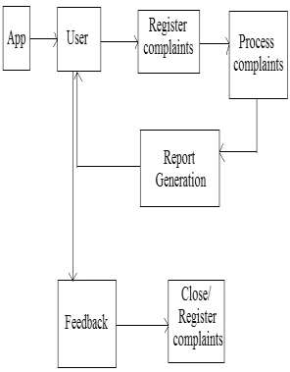
Block diagram of the proposed system architecture for Mobile App

Slide 16
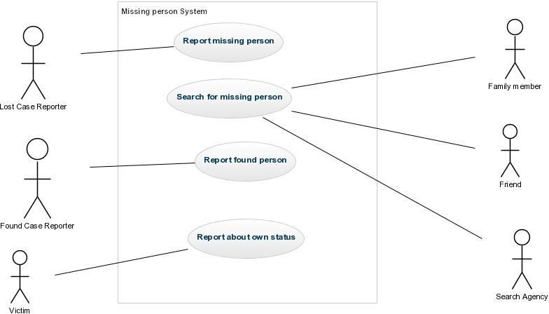
Use Case Diagram:
The system entails a number of use cases which include lost case reporter, found case reporter, lost person, family members, friends and search agency.

Slide 17
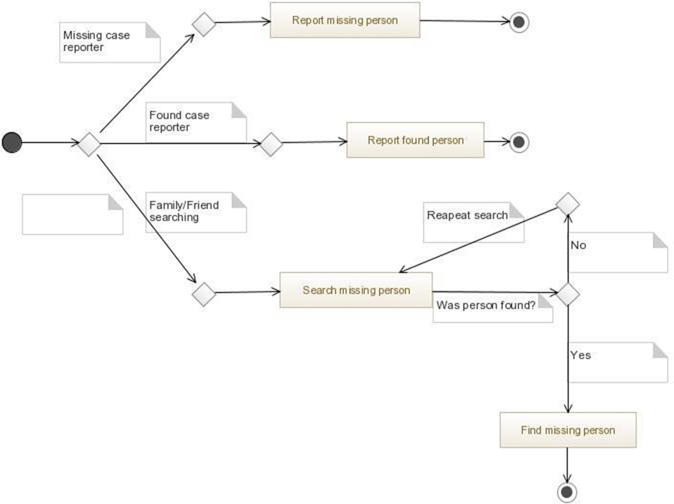
Activity Diagram:
The given Diagram shows various activities involved in the system:

Slide 18
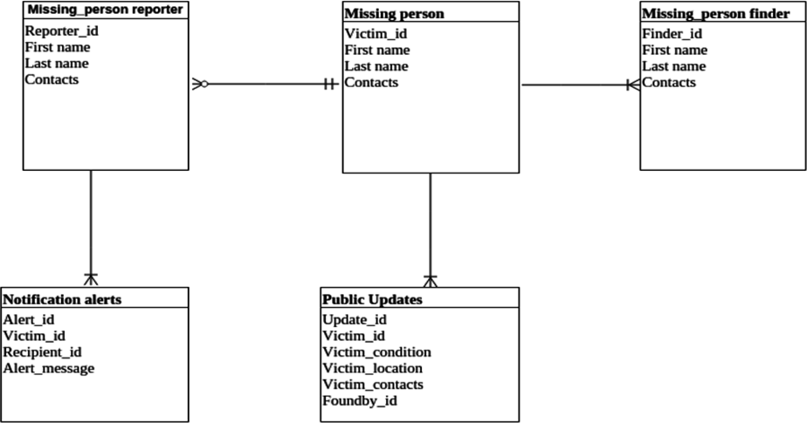
ER (Entity Relationship) Diagram:
This is an Entity Relationship diagram that shows all system entities and their interconnection.

Slide 19
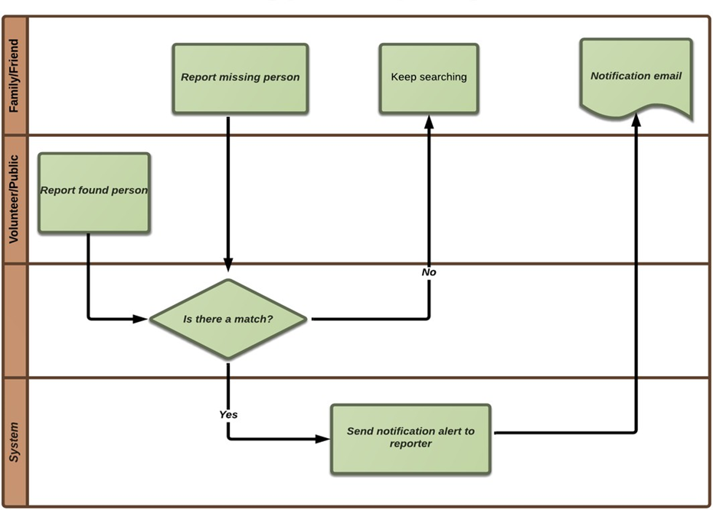
Data Flow CHART
The Data flow chart summarizes the entire system process, from the time a missing case is reported up until the search results and notification alerts.

Slide 20
Module Description:
System Functional Requirements
1. Report Missing Person
In case a person goes missing, family members, friends or acquaintances should be able to report the case on the system. They should be able to do so by registering the person's details such as Name, Age, Gender, Photo, City and Description . This should give an exhaustive description of the missing person to increase chances of the reader spotting and reporting them .

Slide 21
2. Missing person gallery:
Our gallery consists of stock of images of missing victim that people have uploaded to Find the perfect missing people stock photos here.
• There are a wide number of images in gallery to minimize the task we have added filters that makes your searching simple and easier by finding the images of all missing Child or male or female. Also, if you want to find image of missing person by his/her name, that too possible.
3. Sending message:
User can send or receive messages here about the missing victim. This step makes the process more easier .

Slide 22
Admin sector
4.Reporting found person:
A person having been reported as missing can be reported as found if spotted anywhere. Anyone with the leading information should be able to post them on the system .
5. Image comparison:
If anyone finds someone similar to the lost person image that picture will be compare with the found person reports stored in the database.

Slide 23
System Performance / Non-Functional Requirements
A. Efficiency - The system should be able to perform as expected. Given the necessary input, it should give the expected output.
B. Reliability - The system should be available and in good condition whenever it’s required. Availability of components and integrity of data must be ensured. The rate of failure should be seamlessly low. It should also be consistent.
C. Error/Failure Detection and Recovery - Just like any other system, different failure modes and failure consequences are anticipated in this kind of system. To mitigate them in the event that they arise, error logging and reporting will come into play. Manual and automatic recovery procedures will also be applicable at some point.

Slide 24
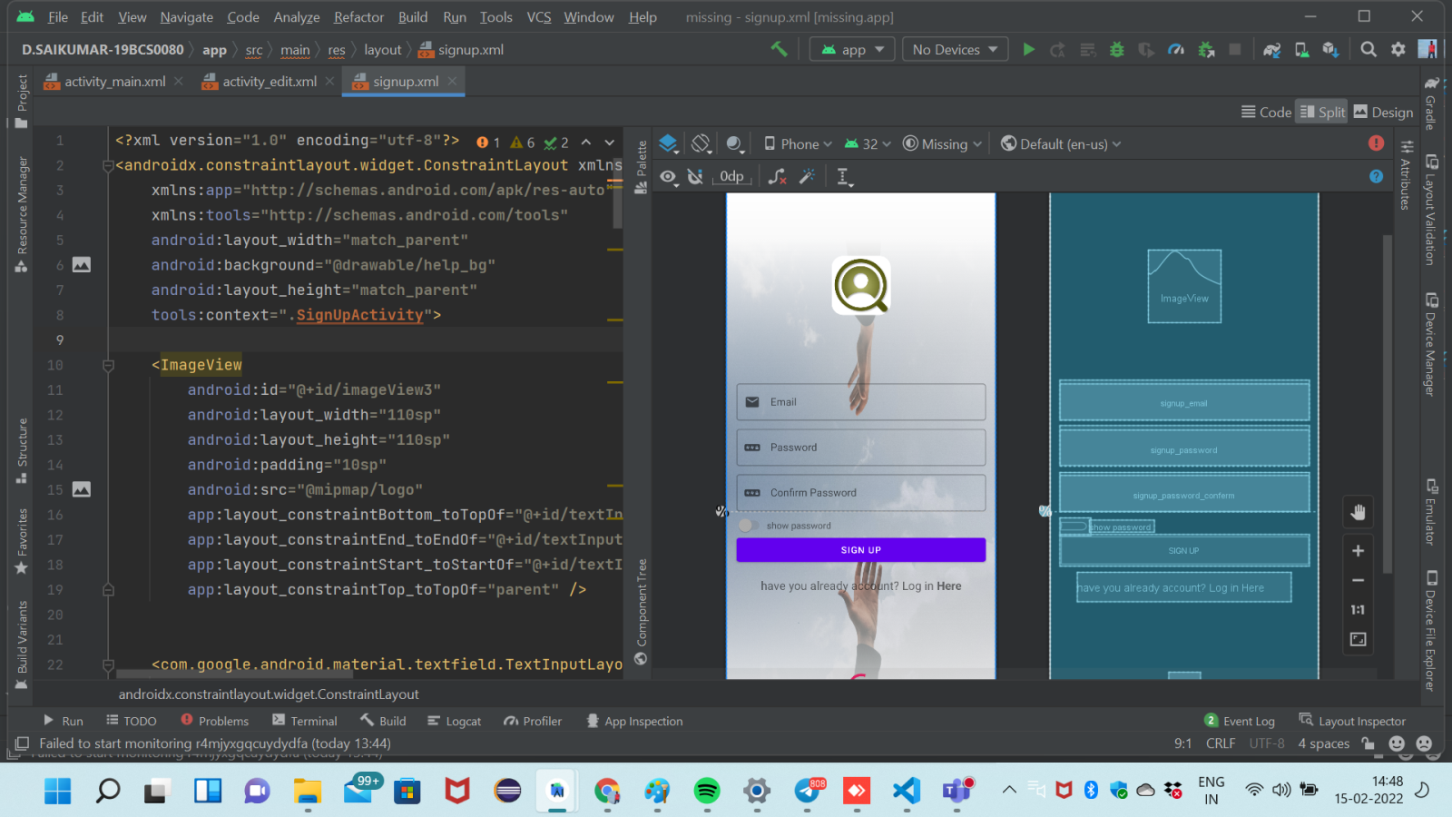
Implementation:
Sign-up Activity:

Slide 25
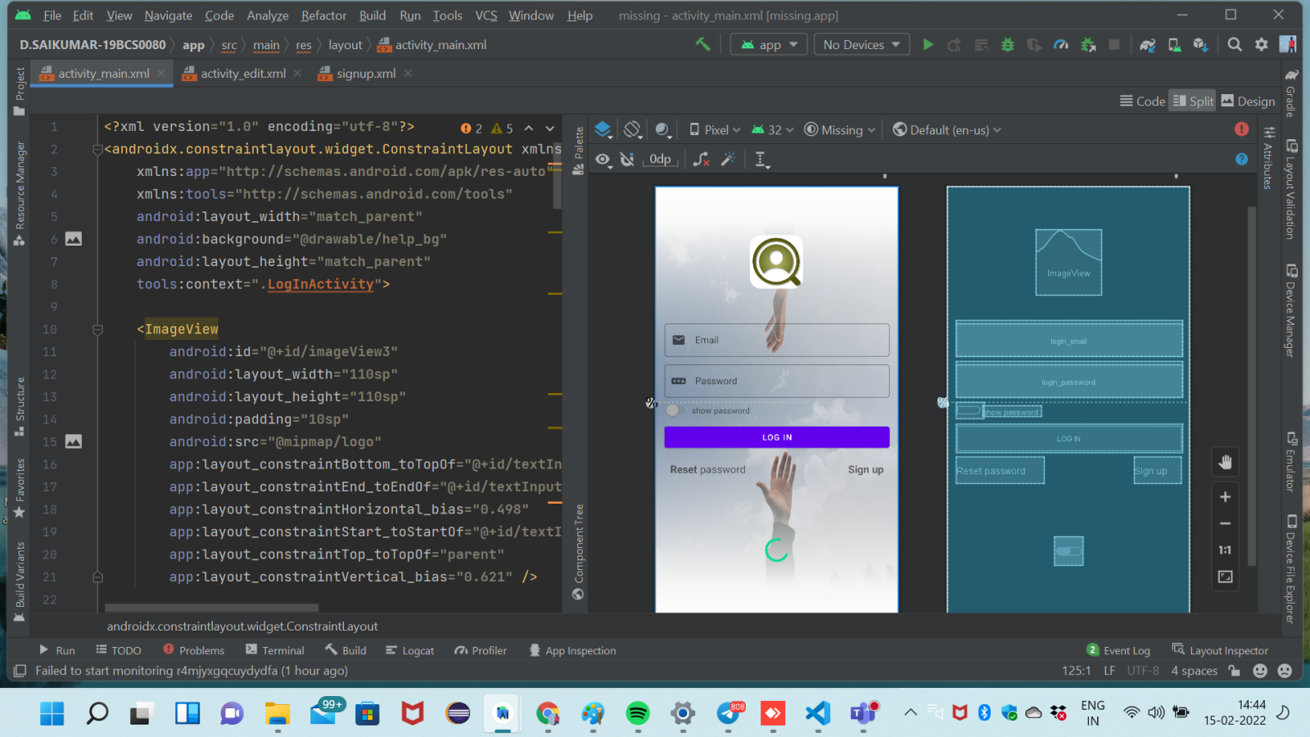
Log-in Activity:

Slide 26
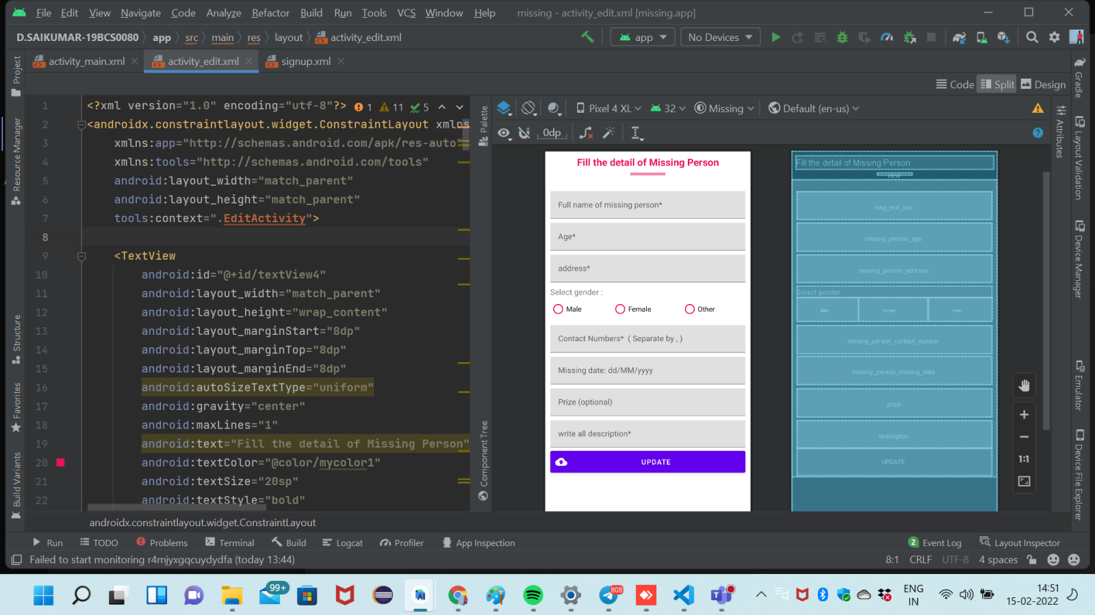
Missing Person Details Form:

Slide 27
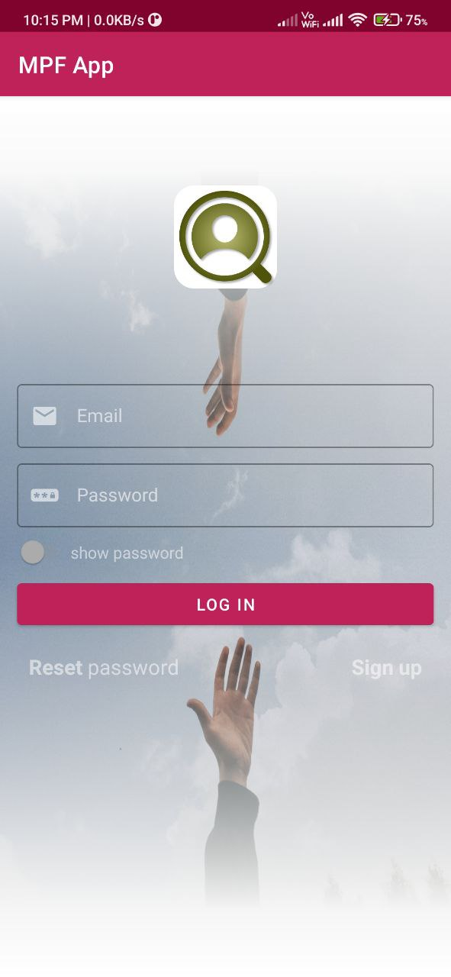
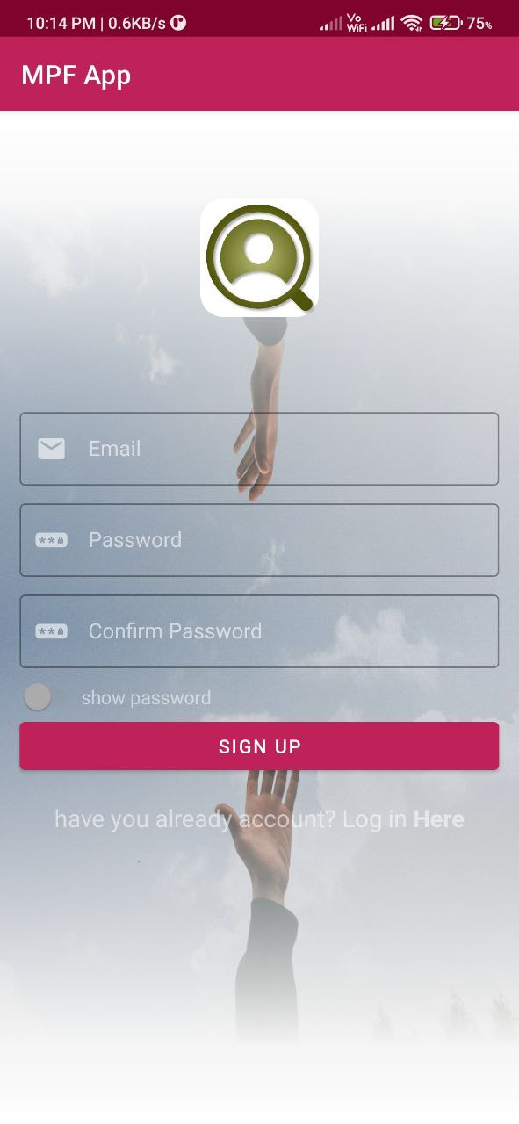
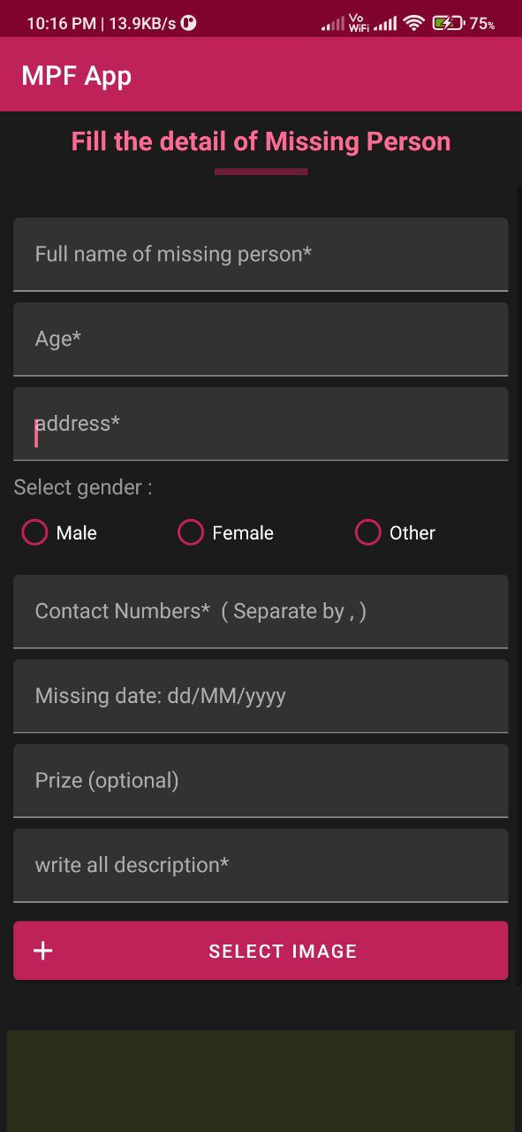
Output
Log-in Activity:
Sign-up Activity:
Missing Person Details Form:

Slide 28
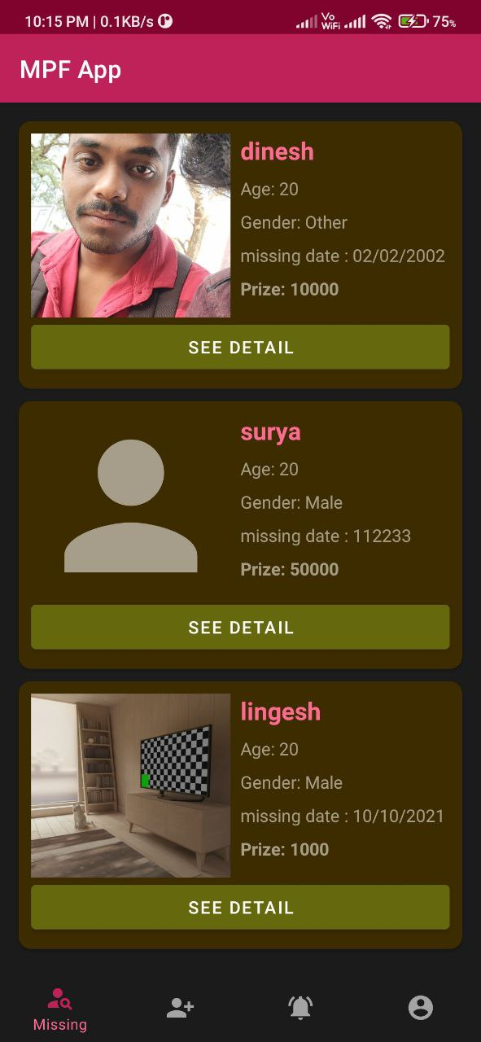
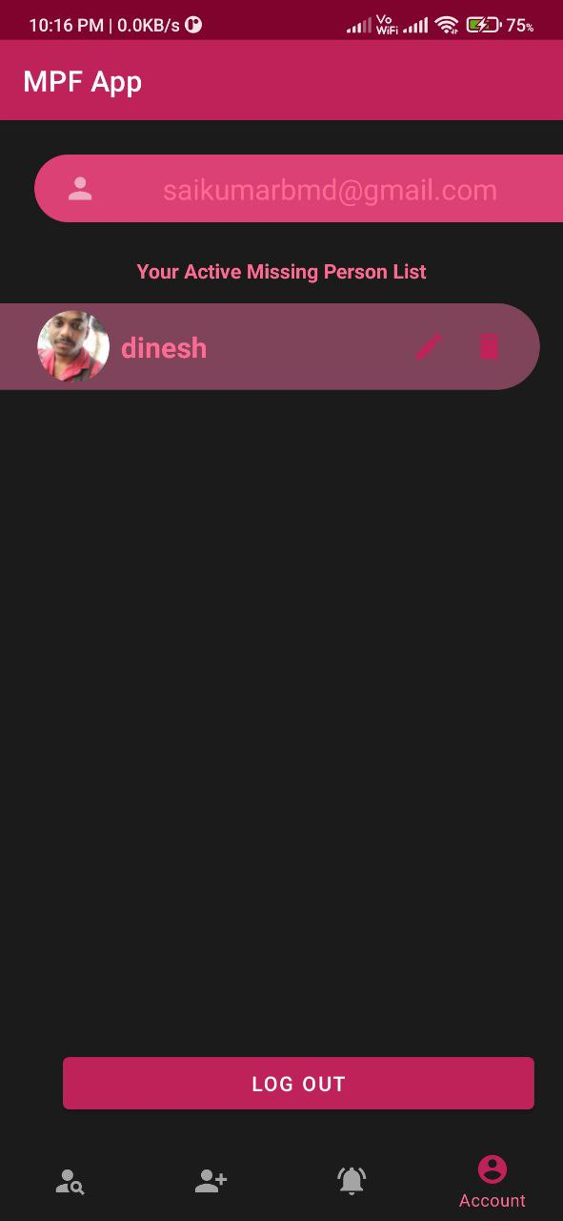
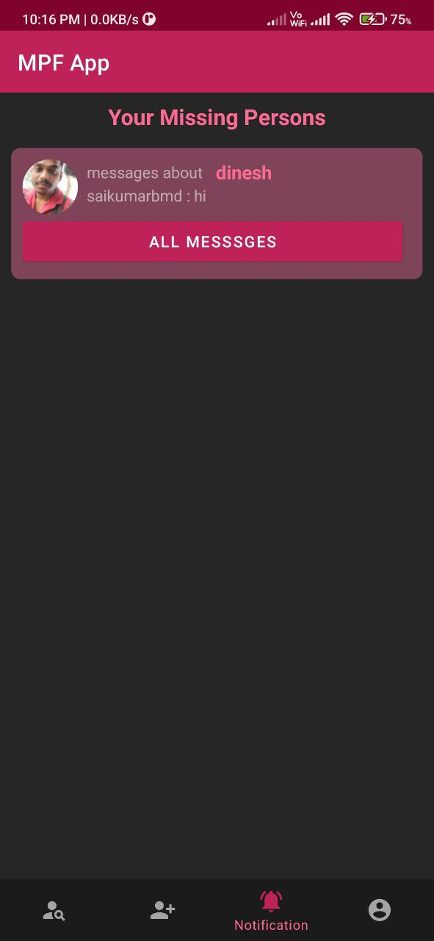
Dash board activity
Profile page
Notification page

Slide 29
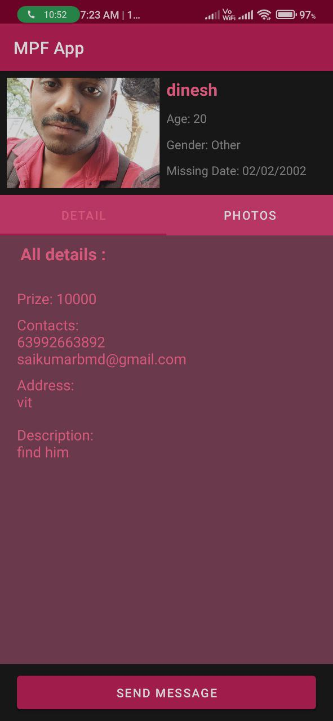
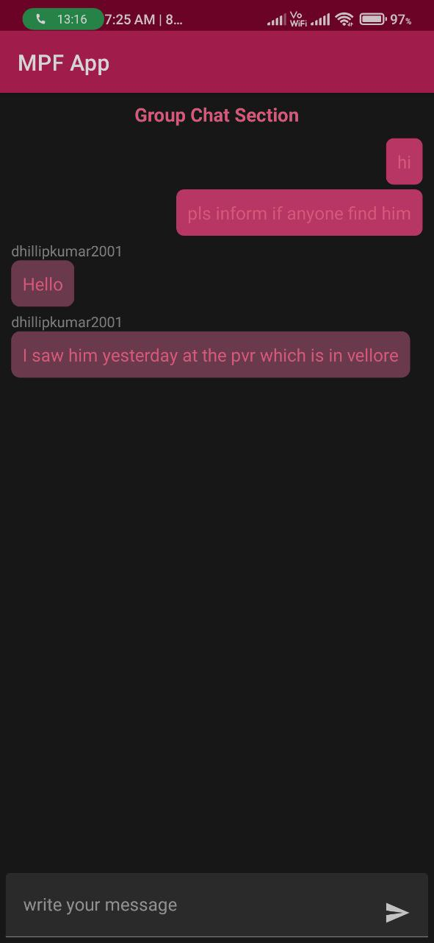
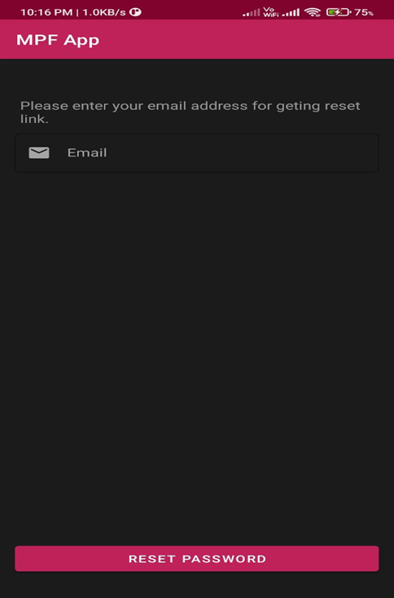
Show details activity
Group chat activity
Reset password activity

Slide 30
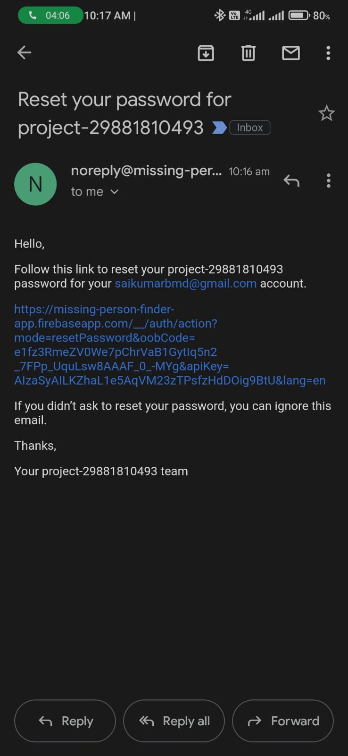
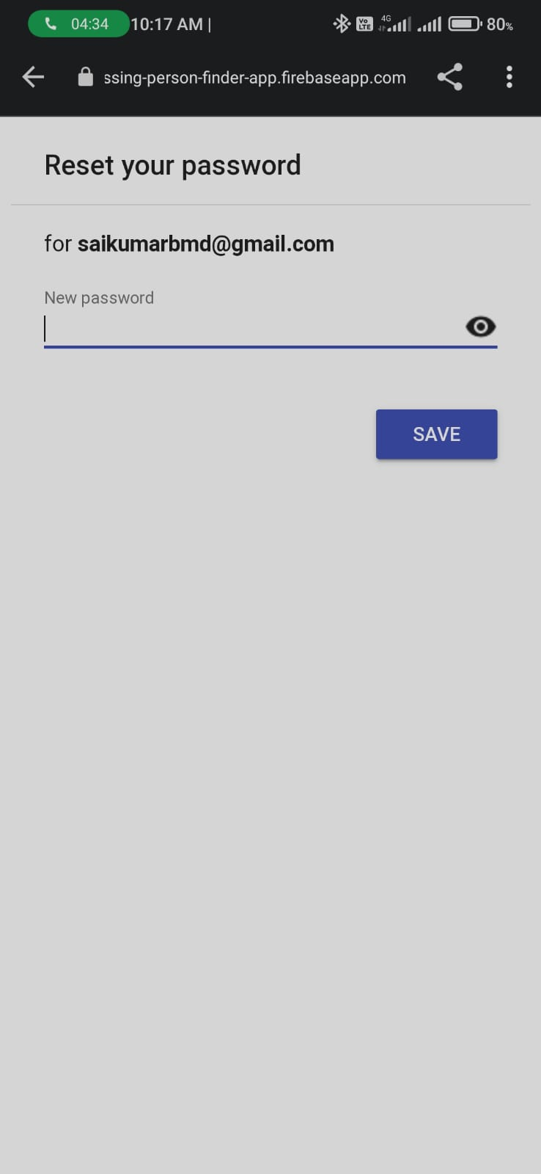
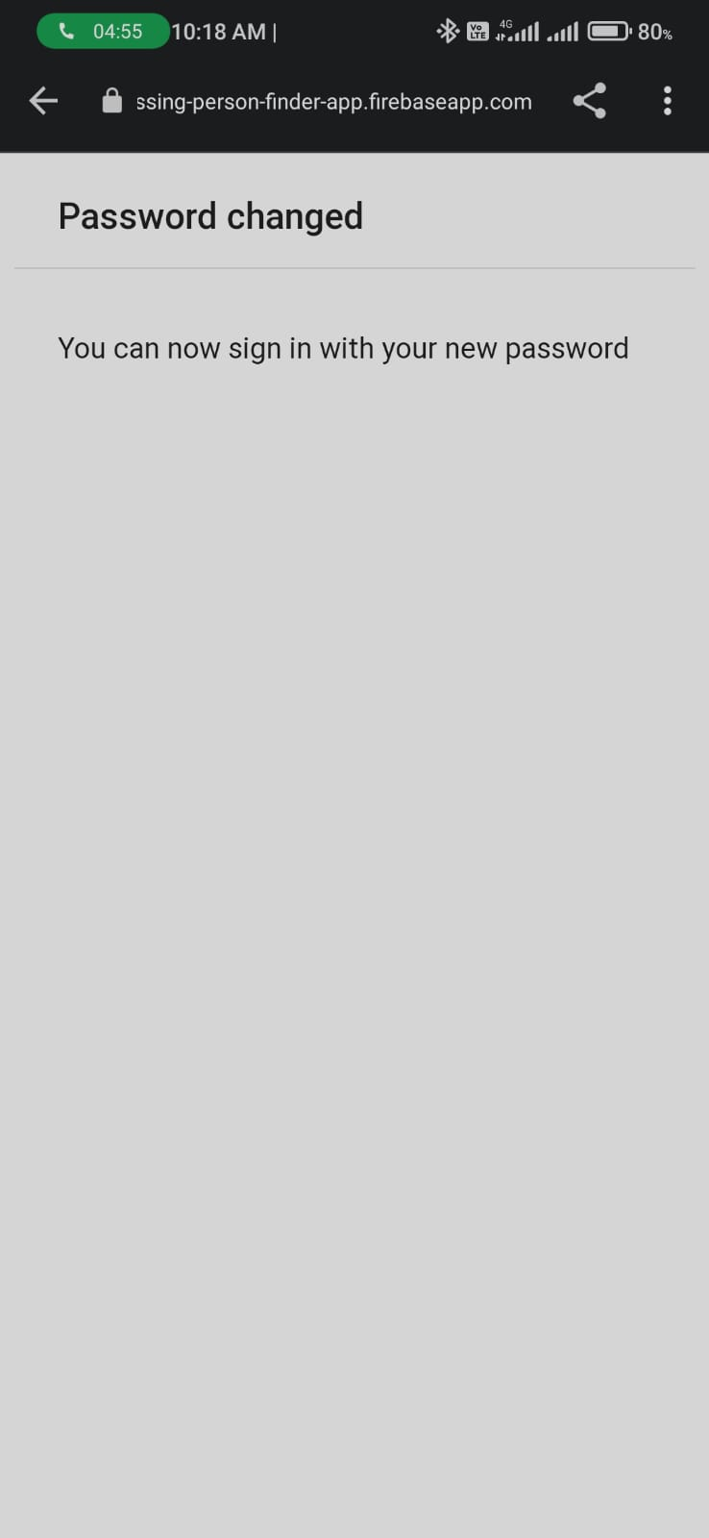
Process take for reset password

Slide 31
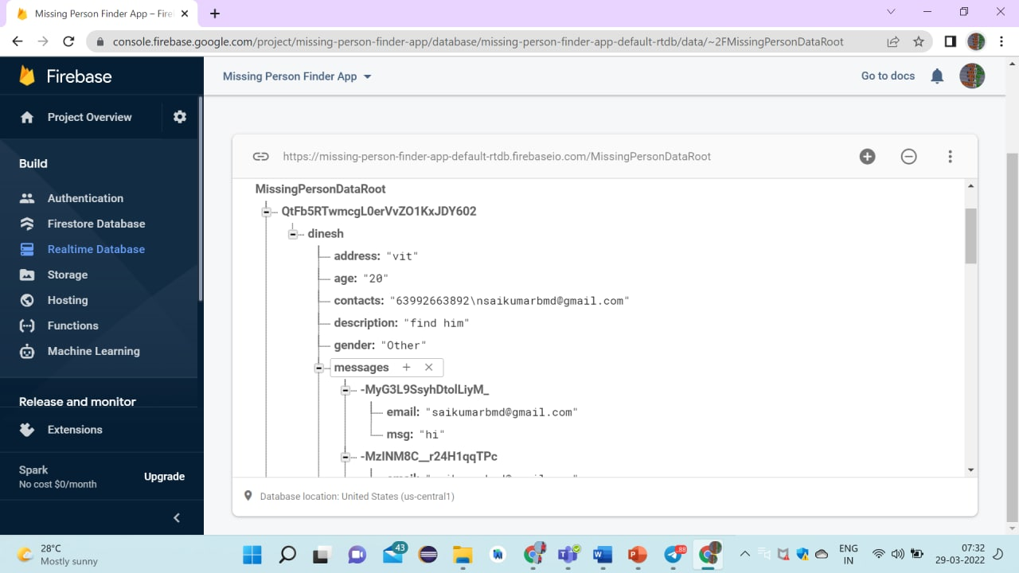
Firebase :

Slide 32
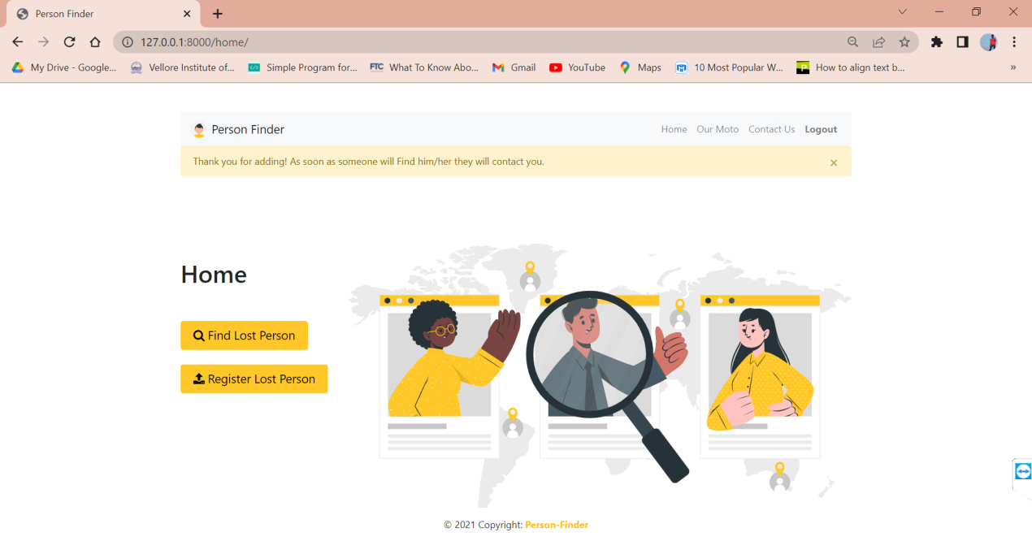
Admin website

Slide 33
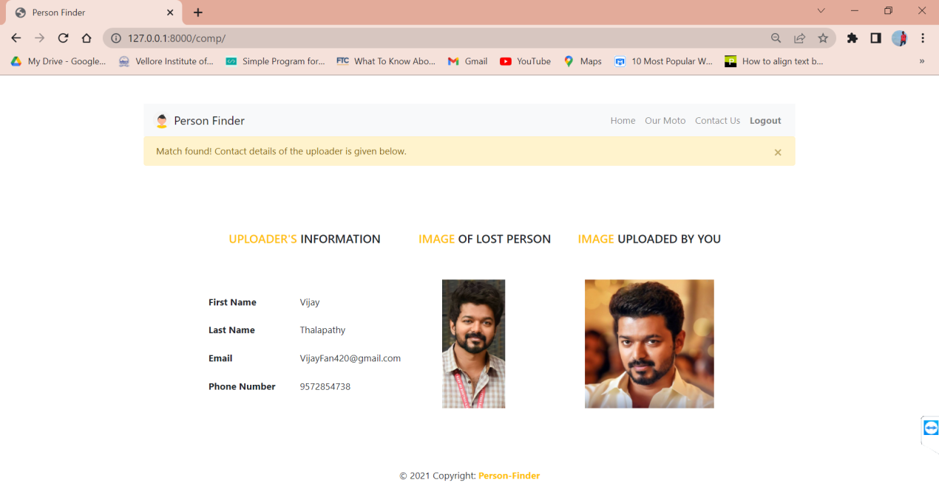

Slide 34
References
[1] Eden, Christoudias, Darrell,“FindingLostChildren” Published in Person Oriented Vision (POV) 2011 ,IEEE
[2] MCIA missing person Alert Android Application On Google play
[3] Rahul Mote And Pooja Rakate, “Android Based Application On Missing Person Finder”, International Of Scientific And Research Development, Vol. 3, No. 1, Pp. 2321-0613, 2015.
[4] Missing Person Stories: https://www.thehindu.com/society/indias-missing-children-what-the-whatsapp-rumours-dont-tell-you/article24641527.ece
[5] Sedlack, Andrea J. (2002)."National Estimates of Missing Children: An Overview". NISMART Series Bulletin: 7, 10. Retrieved November 9,2015.Spector, A. Z. 1989. Achieving application requirements. In Distributed Systems, S. Mullender

Slide 35
Thank you

